Slide 1

Customer Data Management and Predictive Analysis Project
Belal fathy
Omar Adel
Mohmed Elsayed
Youesf Alywa

Slide 2
Project Objectives
Efficient Customer Data Management
Improve Customer Retention and Satisfaction
Improve Decision-Making with Data-Driven Insights
Add a Predictive Analytics for Business Growth

Slide 3
Stages of the project
Week1:
Data Management and SQL Database Setup.
Week2:
Data Warehousing and Python Programming.
Week3:
Predicting Sales Amount Using Machine Learning.

Slide 4


(1) Data Management and SQL Database Setup

Slide 5
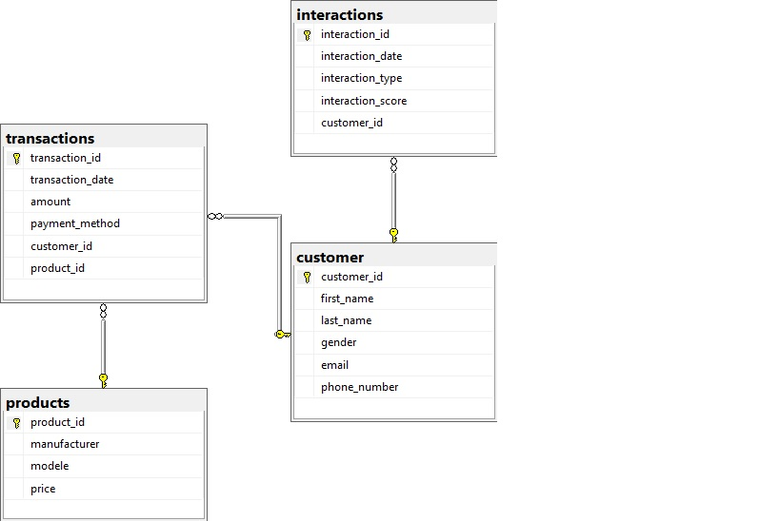
Design a SQL database schema for customer data (profiles, transactions, interactions).

Slide 6
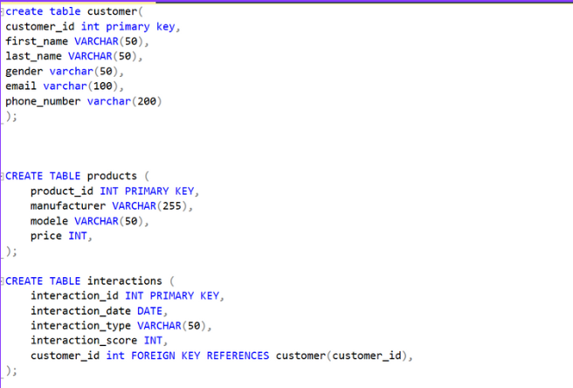
Implement the SQL database using Microsoft SQL Server

Slide 7
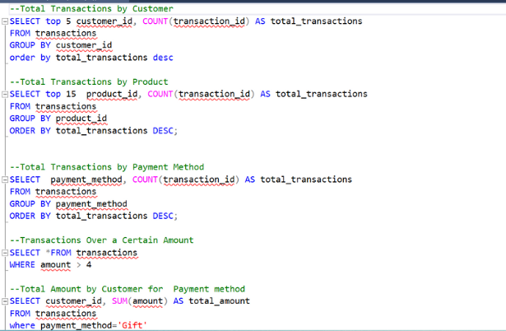
Write SQL queries to extract, update, and analyze customer data

Slide 8

(2)Data Warehousing and Python Programming

Slide 9
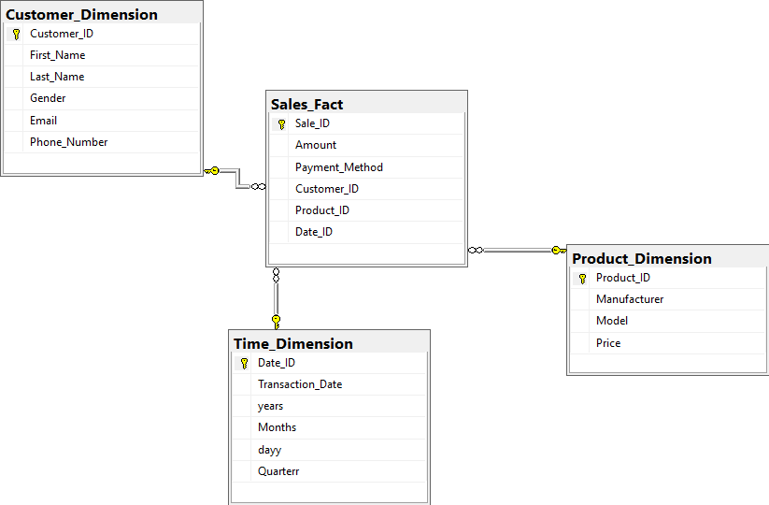
Create schema for data warehouse

Slide 10
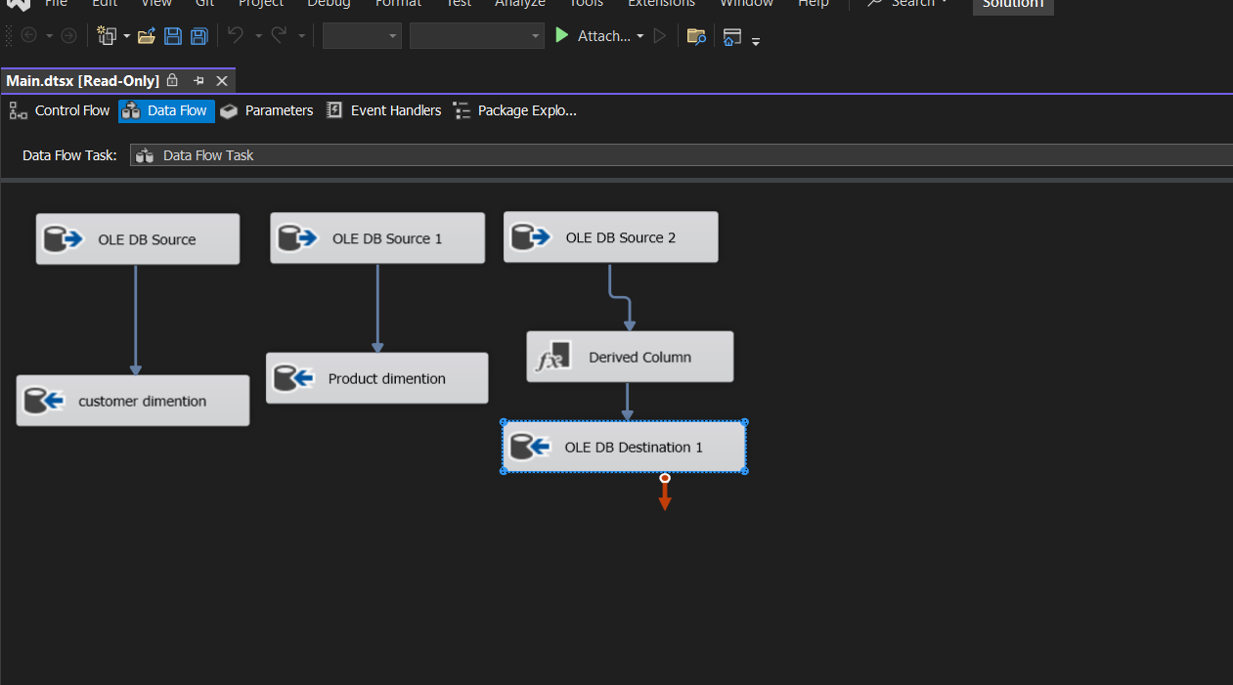
ETL Process Steps

Slide 11
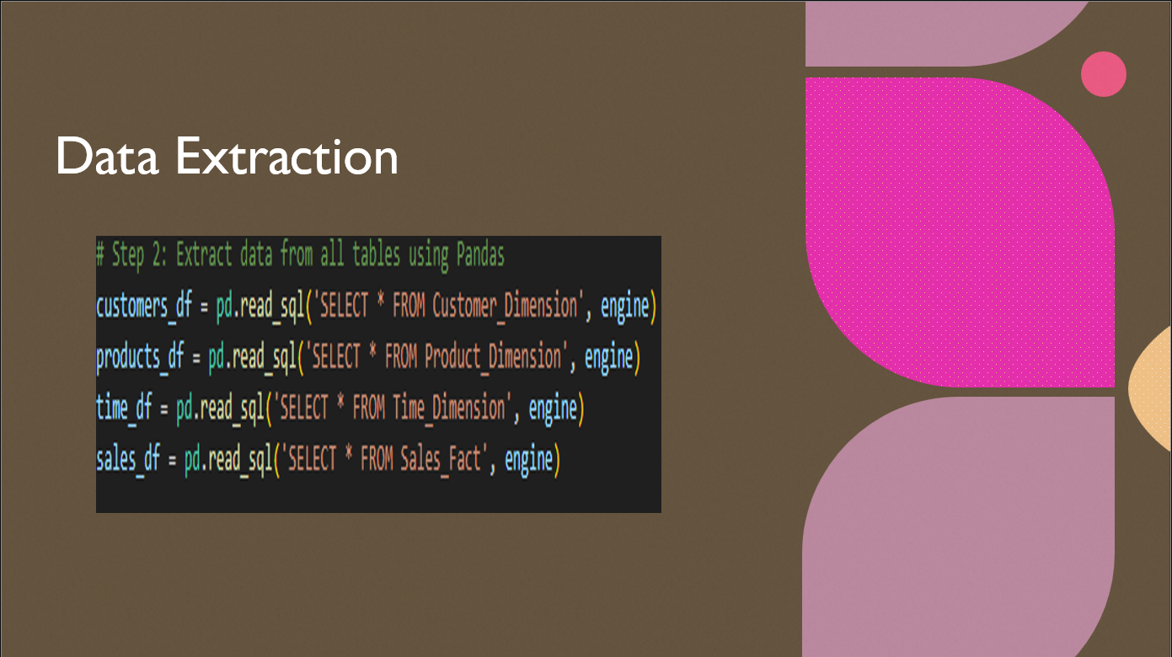

Slide 12


Slide 13


Slide 14
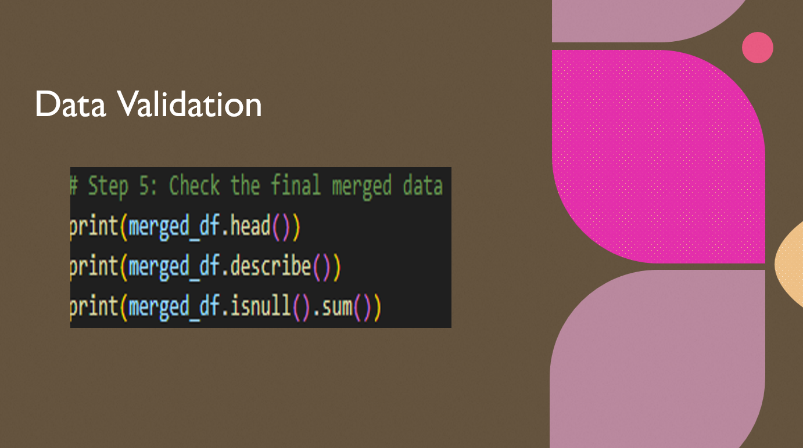

Slide 15

Predicting Sales Amount Using Machine Learning

Slide 16

1. Introduction
Objective: To build a predictive model that estimates sales amounts using historical sales data, product information, and time-related features.
Why Important: Predicting sales helps in forecasting and making informed business decisions regarding inventory management, marketing strategies, and sales targets.

Slide 17
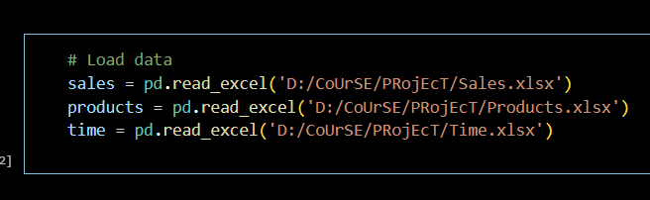
2. Data Used
Datasets:
Sales Fact Table (Sales_Fact.csv): Contains information about each sale, such as the sales amount, payment method, and related product and time IDs.
Product Dimension Table (Product_Dimension.csv): Holds product details such as product ID, price, model, and manufacturer.
Time Dimension Table (Time_Dimension.csv): Contains details about the transaction date, such as day, month, quarter, and year.

Slide 18

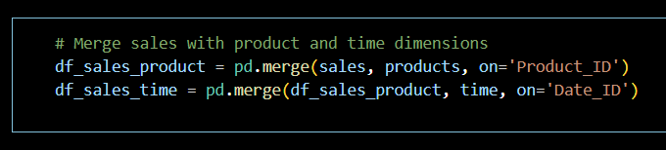
3. Data Preparation
Merging Data:
Merged the Sales Fact table with the Product Dimension table on Product_ID to include product-related features (e.g., price).
Then merged the result with the Time Dimension table on Date_ID to incorporate time-related features (e.g., month, quarter).

Slide 19

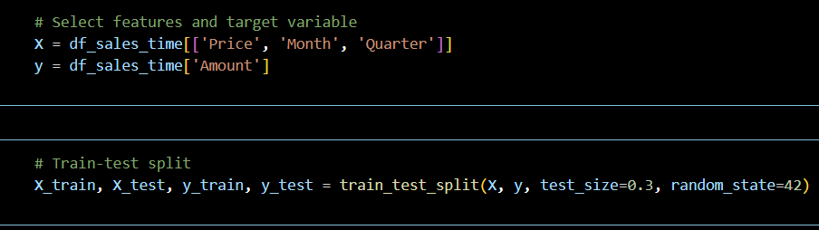
4. Modeling Approach
Target Variable (y): Amount (The total sales amount).
Features (X):
Price: The price of the product sold.
Month: The month of the sale (helps capture seasonality).
Quarter: The quarter of the sale (helps capture larger seasonal trends).
Data Split:
Split the data into training (70%) and testing (30%) sets using train_test_split.

Slide 20

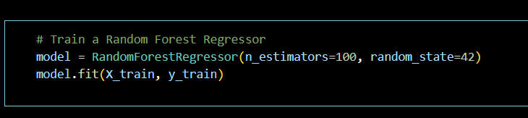
5. Machine Learning Model
Algorithm Chosen: Random Forest Regressor.
Why: Random Forest is an ensemble method that averages multiple decision trees, improving accuracy and preventing overfitting.
Model Configuration:
n_estimators=100 (number of trees in the forest).
random_state=42 to ensure reproducibility.

Slide 21

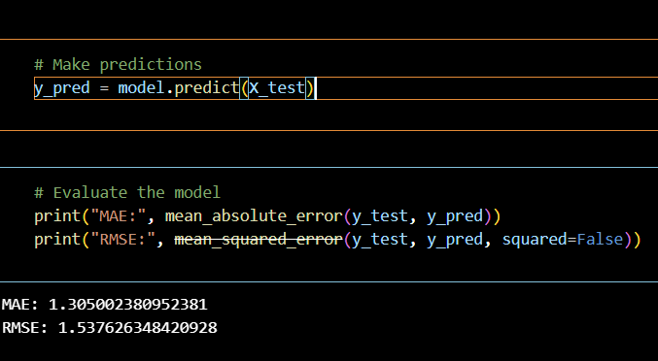
6. Model Evaluation And Results
MAE: How much the model's predictions differ from actual values on average.
RMSE:
The model's overall performance, penalizing larger errors.

Slide 22

THANK YOU

